Slide 1
“PT Management in Flexor Tendon Injury”
Dr. Sanket Mungikar
Dept Of Musculoskeletal Physiotherapy
MGM Institute Of Physiotherapy
Chh.Sambhajinagar

Slide 2
CONTENT
Introduction.
Anatomy.
Pulley system.
Zones of hand.
Zone wise injury.
Surgical management.
Stages of tendon healing.
Physiotherapy management.

Slide 3
INTRODUCTION
Tendon injuries often are the result of a sharp instrument coming into contact with the digit, hand or wrist , occur accidentally at work or in the home self inflicted wound.
In case of accidental injury, the non-dominant hand frequently is hurt because the individual is wielding the knife in the dominant hand when the accident occur.
Spontaneous tendon ruptures can occur without ant preceding trauma.
Avulsion injuries to the flexor tendons usually are caused by a closed traumatic injury to the finger, occur during athletic events.
Flexor digitorum profundus tendon injury is most common.

Slide 4
ANATOMY
The tendons for the flexor muscle groups inserted distally on the metacarpals and phalanges to provide wrist and finger flexion.
The forearm flexor muscles divided into three anatomical layers.
Superficial layer: pronator teres, flexor capri radialis, flexor carpi ulnaris & palmaris longus.
Intermediate layer: flexor digitorum superficialis.
Deep layer: flexor digitorum profundus & flexor pollicis longus. Pronator quadratus muscle
These nine tendons travels through the forearm and enters the wrist through the carpal tunnel beneath the transverse carpal ligament.
The tendons continue in the palmar aspect of the hand, with the FDS tendons travelling anterior to the FDP tendon.

Slide 5
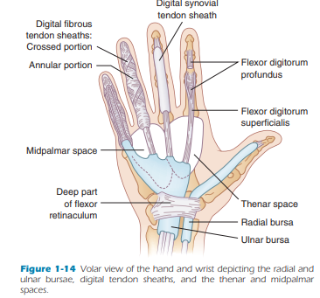
They remain in this arrangement until they enter their individual digits, through the digital sheath at the A1 pulley.
At this point, the FDS tendon divides into two slips, travelling dorsally and on either side of the FDP tendon & FDP inserted along the proximal half of the middle phalanx.
In the digits, the flexor tendons are enclosed in synovial sheaths. This provide a smooth synovial lining for tendon nutrition and to reduce the work of gliding.

Slide 6
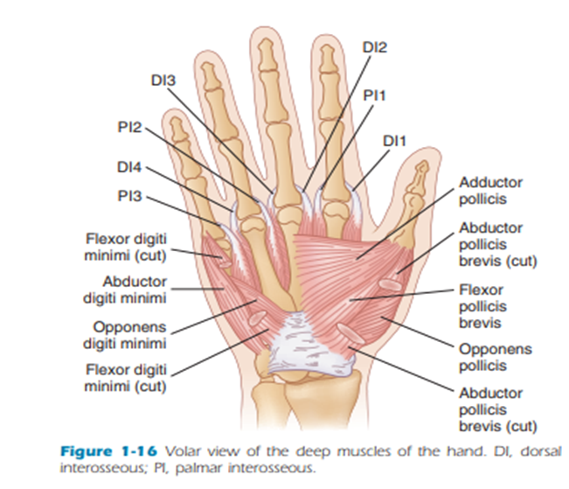

Slide 7
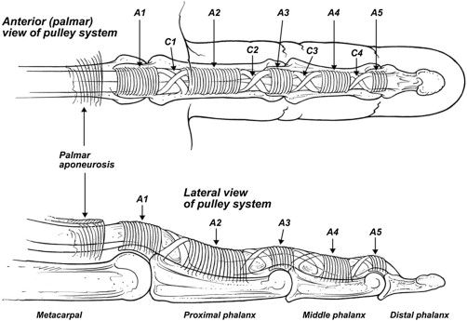
PULLEYS
The pulley system keeps the tendon close to the bone and avoids
bowstringing of the flexor tendons.
There are five pulleys: A1, A2, A3, A4, A5.
The A1, A3, A5 annular pulleys arise from volar plates
of the MCP, PIP, DIP joints.
A2 & A4 pulleys are functionally the most important
pulleys, arising from the periosteum of the proximal
half of the proximal phalanx(A2) and mid portion of the middle phalanx(A4).
Cruciate pulleys: C1(b/w A2-A3), C2(b/w A3 –A4), C3(b/w A4-A5).
They allow the annular pulley to approximate each other during flexion.

Slide 8
ZONES
There are five zones over the volar aspect of the hand and wrist, based on differing anatomical characteristics.
ZONE1: most distal zone, includes the area distal to the insertion of the FDS on the proximal phalanx.
ZONE 2: encompasses the area from the proximal border of zone 1 to the level of the distal palmar crease, which is the beginning of the flexor tendon sheath. Known as “no man’s land” because of the complexity of the flexor tendons & fibro-osseous sheath.
ZONE 3: represents the area between start of the fibro-osseous tendon sheath and the distal edge of the transverse carpal ligament. Also called area of lumbrical muscle origin.

Slide 9
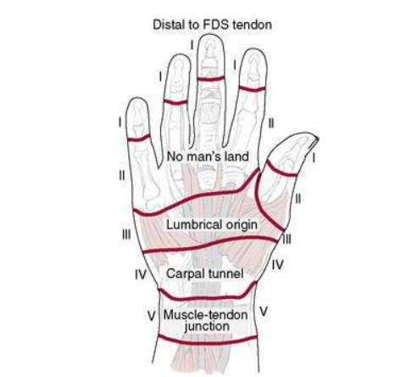
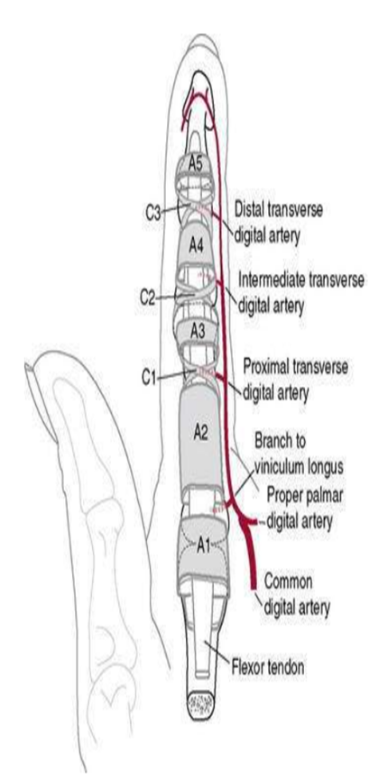
ZONE 4: carpal tunnel region.
ZONE 5: proximal to transverse carpal ligament.
Thumb has it’s own zone distribution.
ZONE T-1: distal to DIP joint.
ZONE T-2: between MCP and IP joints.
ZONE T-3: proximal to the MCP volar flexion crease.

Slide 10
ZONE WISE INJURY
ZONE 1 INJURY
Typically a laceration or avulsion of the FDP tendon only.
Mechanism of injury is usually from forced extension during active flexion which cause the profundus tendon to pull away at its insertion on the distal phalanx.
Among young, male athletes, ring finger involved in more than 75% of cases. Patient has tenderness and swelling over volar aspect of ring finger and unable to flex DIP joint.
Include type 1: proximal portion of tendon retracts into the palm. Type 2: proximal segment of tendon retracts to the level of PIP joint. Type 3: involve avulsion of large bony fragment to which FDP attaches.
Jersey finger.

Slide 11
ZONE 2 INJURY
Referred to as no man’s land because of the difficulty involved in repairing the flexor tendons at this level.
Both the FDP and FDS tendons usually are injured,
ZONE 3 INJURY
Injuries occurs in the region just distal to the carpal tunnel. Both FDP and FDS tendons travel in this region , either one or both tendons may injured.
ZONE 4 INJURY
The carpal tunnel, FDP and FDS tendons travel together, along with the median nerve.
Laceration at this level may result in injury to one or multiple tendons and to the median nerve.
Neurovascular examination must be performed.

Slide 12
ZONE 5 INJURY
Wrist and forearm, the tendons originate from the musculotendinous junctions and travel together toward their insertion sites.
Tendon repair have a favorable prognosis in this region.
THE THUMB
The lacerated proximal portion of the FPL may be located within the thumb, or it may have retracted into the thenar eminence or the carpal tunnel, making retrieval more complicated.
COMPLICATIONS: flexor tendon rupture, contracture at DIP & PIP joint, tendon adhesions .

Slide 13
SURGICAL MANAGEMENT
Surgery takes place within 7-10 days after injury.
Immediate (primary) repair is contraindicated in patients with any of the following: Severe multiple tissue injuries to the fingers or palm, Wound contamination, Significant skin loss over the flexor tendons.
Flexor tendon repair.
Tendon graft surgery.
Teno fix device.

Slide 14
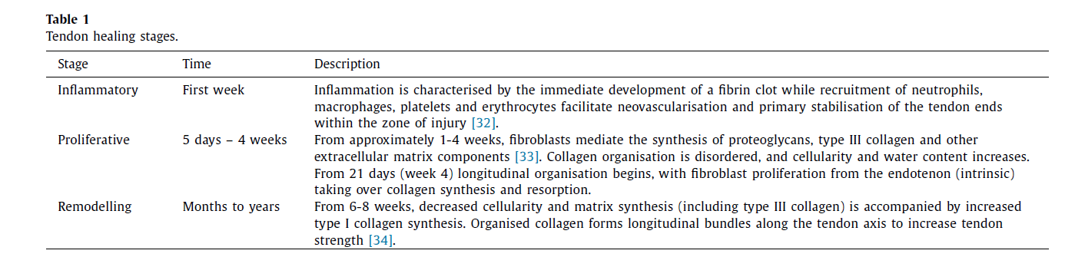
STAGES OF TENDON HEALING
Age, general health, scar formation, motivation and compliance, level of injury, trauma and extent of injury, pulley integrity, surgical technique.

Slide 15
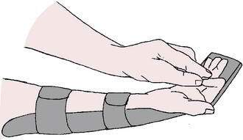
PHYSIOTHERAPY MANAGEMENT
Postoperative Day 1 to Week 4.5
Keep dressing on until Day 5 postoperative. At Day 5: replace with light dressing.
Early low-laser therapy: from day 2(3times/week) 10 session.
Patient is fitted with dorsal blocking splint (DBS).
20 degrees wrist flexion, 45 degrees MCP flexion, PIP & DIP in neutral.
Hood of splint extends to fingertips.
Controlled passive motion twice daily within splint.
8 repetitions of passive flexion and active extension of the PIP & DIP joint.
8 repetitions of active composite flexion and extension of the DIP and PIP joints with the wrist and MCP joints supported in flexion.

Slide 16
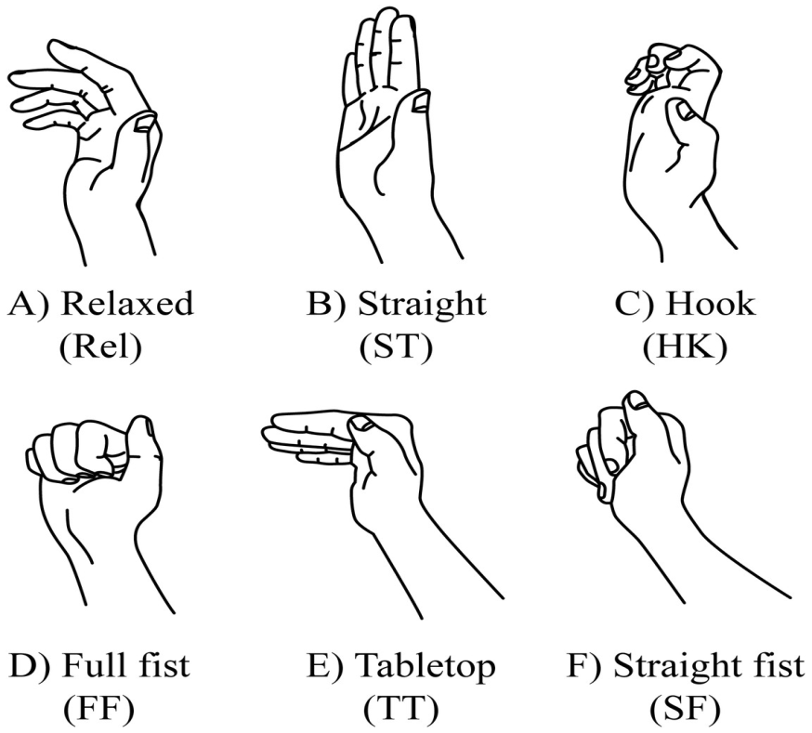
4.5 Weeks
Continue passive exercises as needed.
Removal of DBS every 2 hours to perform 10 repetitions of each active flexion and extension of the wrist and of the digits.
Start intrinsic minus (hook fist) position and/or tendon gliding exercises
Active wrist extension to neutral only
Functional electrical stimulation (FES) with the splint on.

Slide 17
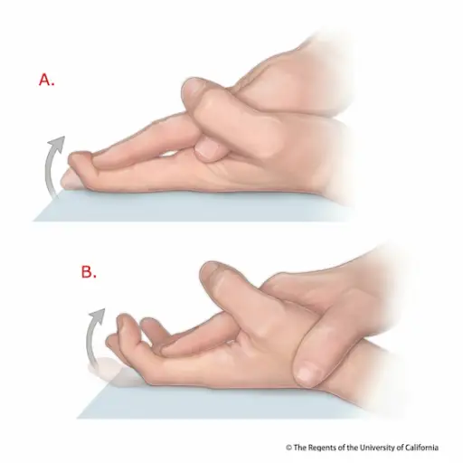
5.5 Weeks
Continue passive exercises.
Discontinue use of DBS.
12 repetitions of PIP & DIP blocking exercise.
12 repetitions of composite active flexion and extension.
May start PROM into flexion with overpressure
6 weeks
Place-and-hold approach.
Dynamic approach.
Combined approach.

Slide 18
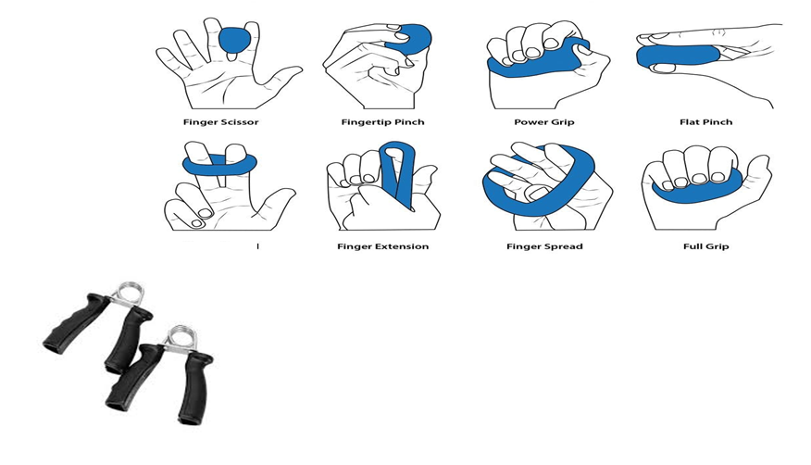
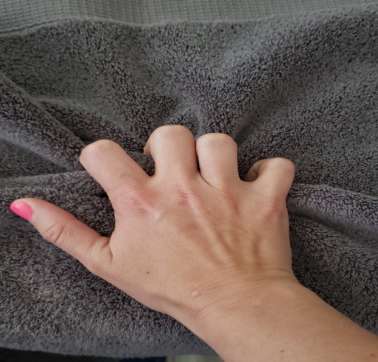
8 weeks
Initiate gentle strengthening.
Putty, ball squeezes.
Towel walking with fingers.
No lifting or heavy use of the hand
Gripping exercise.
10–12 weeks
Return to previous level of activity, including work and sport activities.

Slide 19
Recent Advances

Slide 20
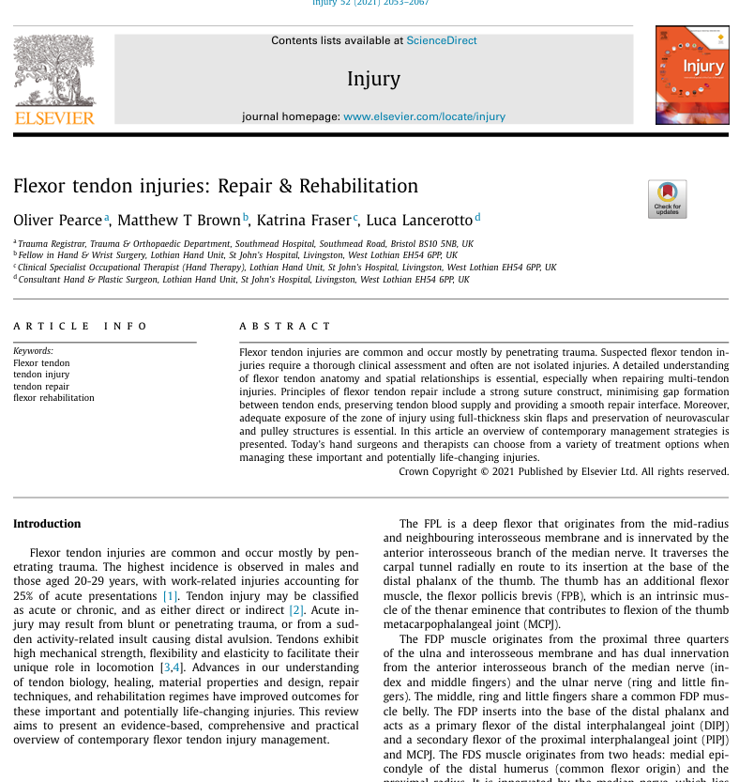
Injury
2023

Slide 21
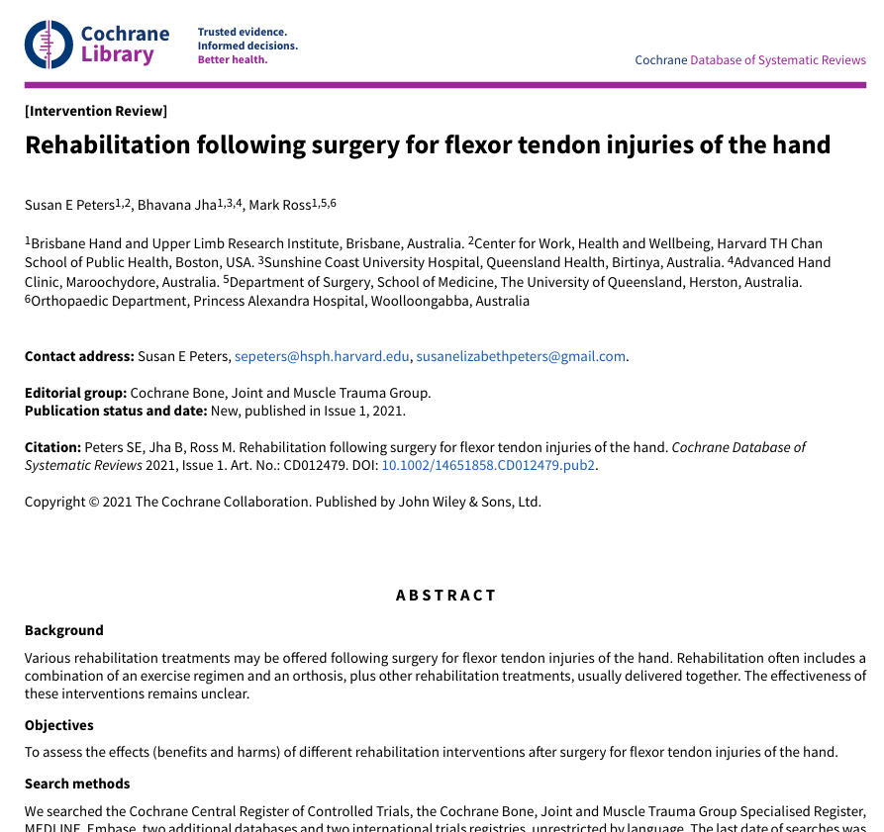
Cochrane Database of Systematic Reviews
2021

Slide 22
REFERENCES
S Brent Brotzman. Clinical orthopaedic rehabilitation., 4th edition.
David j. Magee. Pathology and intervention in musculoskeletal rehabilitation.2nd edition.
Carolyn Kisner. Therapeutic exercise.7th edition.
Skirven & Osterman. Rehabilitation of the hand and upper extremity.6th edition.
Early Low-Level Laser Therapy Improves the Passive Range of Motion and Decrease Pain in Patients with Flexor Tendon Injury (2018).
Postsurgical Rehabilitation of Flexor Tendon Injuries (2019).
Flexor tendon injuries: Repair & Rehabilitation (2021).
Pearce O, Brown MT, Fraser K, Lancerotto L. Flexor tendon injuries: repair & rehabilitation. Injury. 2021 Aug 1;52(8):2053-67
Peters SE, Jha B, Ross M. Rehabilitation following surgery for flexor tendon injuries of the hand. Cochrane Database of Systematic Reviews. 2021(1).

Slide 23
THANK YOU

